Slide 1
Chapter 9: Object Interaction Modeling

Slide 2
Key Takeaway Points
Object interaction modeling helps the development team
  understand the existing business processes,
  and design object interaction behaviors to improve the business.
Actor-system interaction modeling and object interaction modeling deal with foreground processing and background processing of a use case, respectively.
9-<number>

Slide 3
OIM in the Methodology Context
Business goals
& needs
Current situation
Use case-iteration allocation matrix
Accommodating
Requirements Change
Customer
feedback
Acquiring
Requirements
Iteration use cases
Domain Modeling
Preliminary requirements
Domain model
Domain model
Deriving Use Cases
from Requirements
Actor-System Interaction Modeling
Abstract & high level use cases, use case diagrams
Expanded use cases & UI design
Allocating Use Cases & Subsystems
to Iterations
Behavior Modeling &
Responsibility Assignment
Behavior models
Use case-iteration allocation matrix
Deriving Design Class
Diagram
Producing an Architecture Design
Design class diagram
Software architecture
Test Driven Development, Integration, & Deployment
(a) Planning Phase
(b) Iterative Phase – activities during each iteration
control flow
data flow
control flow & data flow
9-<number>

Slide 4
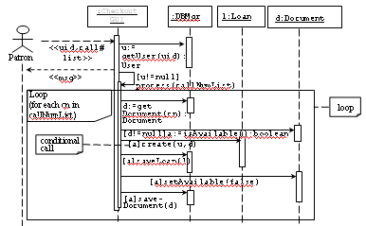

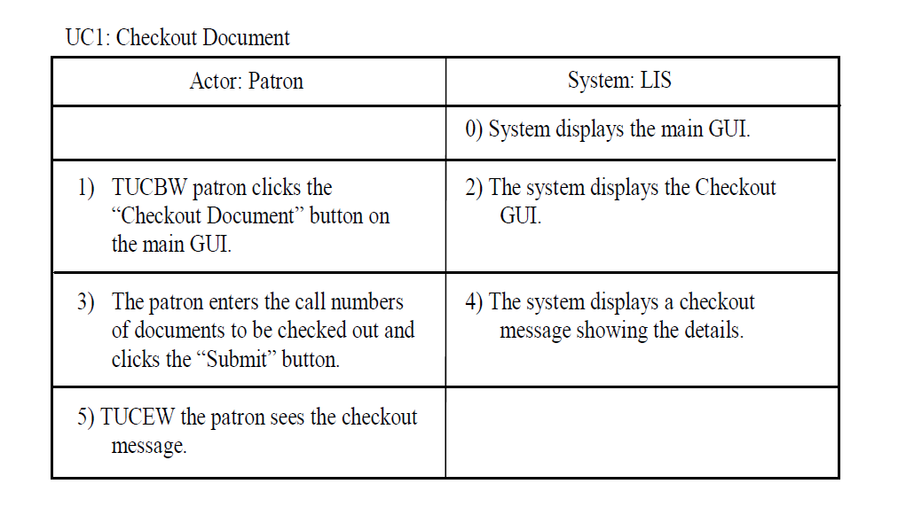
Actor-System Interaction & Object Interaction
Actor-system interaction
Object interaction
Foreground processing of use case.
Acquiring actor input and actor action.
Displaying system responses.
Background processing of use case by objects.
Designing high-level algorithms to process actor requests.
Producing system responses.
9-<number>

Slide 5
Object Interaction Modeling
OIM specifies how objects interact with each other to carry out the background processing of a business process.
Object interaction modeling is aided by the specification of scenarios and scenario tables.
A scenario is an informal, step-by-step description of object interaction.
A scenario table organizes the interaction into a five column table - it facilitates translation to a sequence diagram.
9-<number>

Slide 6




Object Interaction Modeling Steps
domain model, design class diagram from last iteration
scenario descriptions
scenario tables
(3) Constructing scenario tables
(4) Constructing sequence diagrams
sequence
diagrams
(2) Describing scenarios
design sequence
diagrams
(1) Collecting info about business processes
to deriving a
design class diagram
(chapter 11)
expanded use cases for current iteration
business processes info.
feedback, if any
(5) Review and inspection
9-<number>

Slide 7
Steps for Interaction Modeling
Step 1. Collecting information about business processes.
Step 2. Describing scenarios
  Identify and mark nontrivial steps in the right column of each expanded use case.
    A nontrivial step is one that requires background processing.
    It goes beyond the presentation layer (i.e., the Graphical User Interface or GUI).
  For each nontrivial step, describe:
    How objects interact to process the actor request.
    Begin with the step on the left column of the nontrivial step.
Step 3. Convert the scenario into a scenario table, if desired.
Step 4. Convert the scenarios/scenario table into a sequence diagram.
Step 5. Check the OIM model for desired properties.
9-<number>

Slide 8
How to Identify a Nontrivial Step?
If the step does not require background processing, then it is a trivial step.
If the system response simply displays a menu, or input dialog, then it is a trivial step.
If the step displays the same system response for all actors, then it is a trivial step.
If the system response is different for different actors, then it is a nontrivial step.
9-<number>

Slide 9
Example
*
nontrivial
step
9-<number>

Slide 10
Scenarios
Each sentence of the scenario is a declarative sentence consisting of
  a subject,
  an action of the subject,
  an object that is acted upon, and
  possibly other objects required by the action.
The sentences are arranged in a scenario table to
  facilitate scenario description and
  facilitate translation into a sequence diagram
9-<number>

Slide 11
Scenario Description
3) The patron enters the call numbers of documents to be checked out and clicks the Submit button.
4.1) Checkout GUI checks out the documents with the checkout controller using the document call numbers.
4.2) Checkout controller creates a blank msg.
4.3) For each document call number,
4.3.1) The checkout controller gets the document from the database manager (DBMgr) using the document call number.
4.3.2) DBMgr returns the document d to the checkout controller.
4.3.3) If the document exists (i.e., d!=null)
4.3.3.1) the checkout controller checks if the document is available (for check out).
4.3.3.2) If the document is available for check out,
4.3.3.2.1) the checkout controller creates a Loan object using patron p and document d,
4.3.3.2.2) the checkout controller sets document d to not available,
4.3.3.2.3) the checkout controller saves the Loan object with DBMgr,
4.3.3.2.4) the checkout controller saves document d with the DBMgr,
4.3.3.4.5) the checkout controller writes “checkout successful” to msg.
4.3.3.3) else,
4.3.3.3.1) the checkout controller writes “document not available” to msg.
4.3.4) else
4.3.4.1) the checkout controller writes “document not found” to msg.
4.4) The checkout controller returns msg to Checkout GUI.
4.5) Checkout GUI displays msg to patron.
Could be simplified, e.g.,
reducing the number of steps.
9-<number>

Slide 12
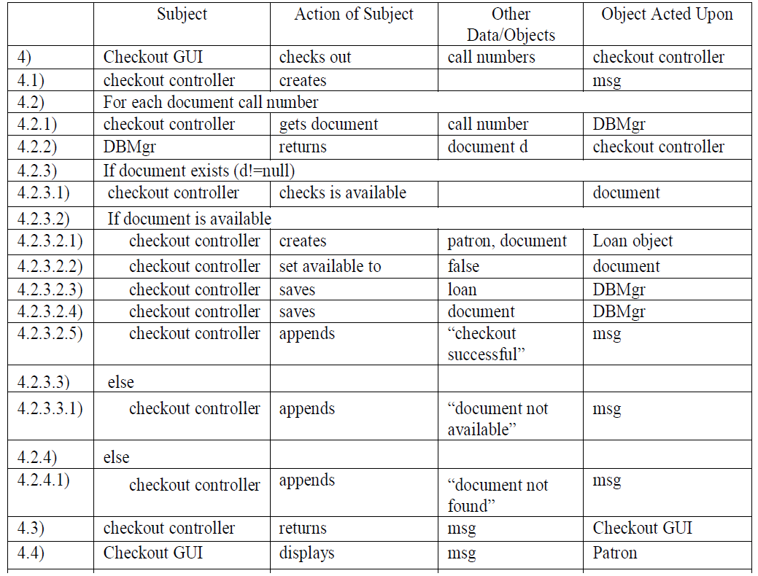
(Message)
Could be simplified, e.g.,
reducing the number of steps.
9-<number>

Slide 13
Guidelines for Scenario Construction
Specify the normal scenario first (i.e., assume everything will go as expected).
If needed, augment the normal scenario with alternative flows.
Keep it simple and stupid --- leave details to coding.
Leave exception handling to coding.
It is sometimes desirable to construct a prototype to validate design idea.
9-<number>

Slide 14
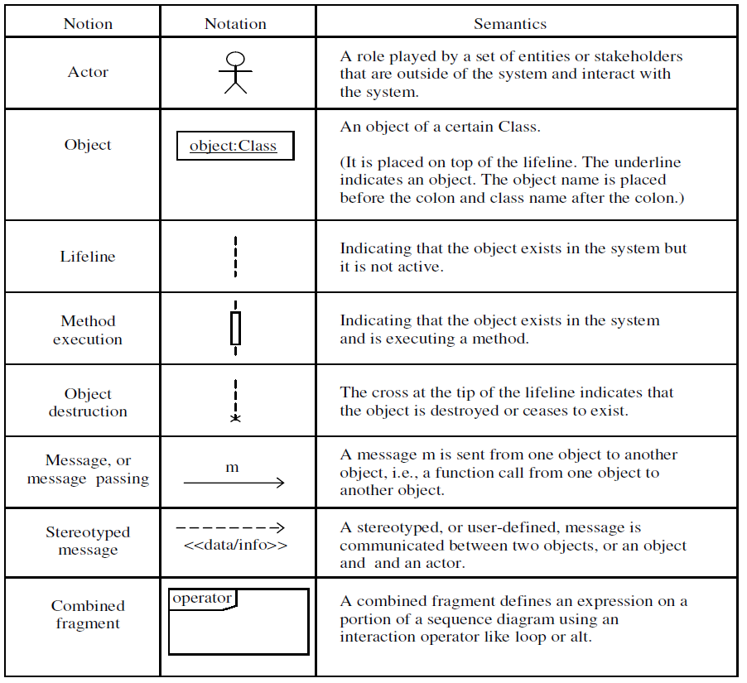
Sequence Diagram Notions and Notations
9-<number>

Slide 15

From Scenario Table to Sequence Diagram
:object acted upon
for each line of the scenario table:
Case 1: subject is an Actor.
action + other
objects/data
object
acted upon
Actor
Example:
card scanner:
<<slide card>>
Patron
9-<number>

Slide 16
From Scenario Table to Sequence Diagram
object:
Case 2: subject is an object and object acted upon is an actor.
<<message>>
actor
Subject
Subject Action
Other Data / Objects
Object Acted Upon
system
displays
confirmation message
Patron
system:
<<confirmation message>>
Patron
9-<number>

Slide 17

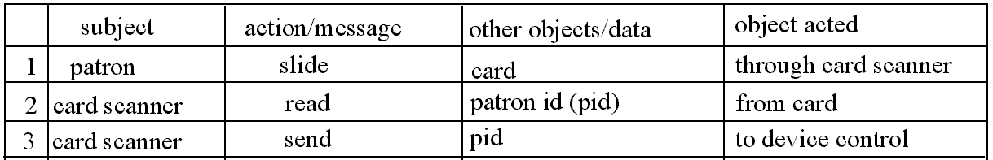
From Scenario Table to Sequence Diagram
: Subject
:object acted upon
Case 3: both subject and object acted upon are objects.
action + other
objects/data
action
performing
Example
cards canner:
device control:
action
performing
send pid
9-<number>

Slide 18
From Scenario Table to Sequence Diagram
Case 4: both subject and object acted upon are the same (a special case of case 3).
object1:
action + data / objects
return value if any
Other Data/ Objects
Object Acted Upon
Subject
Subject Action
shipment
compute base rate
shipment
shipment:
compute base rate
9-<number>

Slide 19
Difference of Analysis and Design
Analysis
application problem-oriented
models application domain
describes what the world is
project-oriented decisions
should allow design alternatives
Design
software solution-oriented
models the software system
prescribes a software solution
system-oriented decisions
usually reduces implementation choices
9-<number>

Slide 20
Modeling a Manual Library System
Patron presents id card to librarian.
:Librarian
These are analysis sequence diagrams that model an existing system.
<<id card>>
Patron
Librarian pulls out patron’s folder using id number.
:Librain
:PatronFolders
<<uid, pass-word>>
get folder using patron id
patron folder
Patron
9-<number>

Slide 21

Analysis/Informal Sequence Diagram
info exchange b/t actor and object
:LoginGui
an object of LoginGui class
<<uid, password>>
the object is processing the request.
Patron
Patron submits uid and password
to LoginGui.
:LoginGui
:LoginController
<<uid, pass-word>>
verify uid and password
LoginGui calls LoginController to
verify the login. The controller returns a msg indicating result of verification. LoginGui shows msg to Patron.
<<msg>>
<<msg>>
Patron
9-<number>

Slide 22

From Analysis to Design
:LoginGui
:LoginController
<<uid, pass-word>>
LoginGui calls LoginController to
verify the login. The controller returns a msg indicating result of verification. LoginGui shows msg to Patron.
verify uid and password
<<msg>>
<<msg>>
Patron
:LoginGui
:LoginController
<<uid, pass-word>>
msg := verify (uid:String, password: Password) : String
Patron
<<msg>>
return value
function call
parameter & type
return type
9-<number>

Slide 23
Sequence Diagram: Flow of Control
:LoginGui
:LoginController
1
2
<<uid, pass-word>>
msg := verify (uid:String, password: Password) : String
<<msg>>
Patron
3
(1) Patron submits uid and password to LoginGui object.
(2) LoginGui object calls the verify function of a LoginController object. The called function returns msg of type String.
(3) The LoginGui object shows msg to patron.
9-<number>

Slide 24

An Analysis Sequence Diagram
real world object within the library system
collection
:Librarian
:Patron Folder
book:Book
f:Patron Folder
id card, book
get patron folder w/id
patron
patron folder f
[patron folder not found] error msg, id card
outside
library
system
[patron folder found] get book card
book card
[patron folder found] insert book card into patron folder
[patron folder found] id card, book
[patron folder found] return patron folder
This an analysis sequence diagram models the current, manual operation, little design decision is made.
9-<number>

Slide 25

A Design Sequence Diagram
:CheckoutGUI
:DBMgr
l:Loan
d:Document
<<uid,call# list>>
u:=getUser
(uid):User
Patron
<<msg>>
[u!=null] process(callNumList)
Loop (for each cn in callNumList)
d:=get
Document(cn):
Document
loop
[d!=null]a:=isAvailable():boolean
conditional
call
[a]create(u,d)
[a]saveLoan(l)
[a]setAvailable(false)
[a]save-
Document(d)
9-<number>

Slide 26
Representing Various Object Instances
Notation Notion and Meaning
myCar:
A named instance without a type, the
type is not important, unknown, or to be determined at run time
myCar: Car
A named instance with a type, this is
commonly used
An unnamed instance with a type, the
name is not important, or not used
elsewhere in the sequence diagram
:Car
:Car
Multiple instances or a collection of objects of a class
9-<number>

Slide 27
From Sequence Diagram to Implementation
:Checkout
GUI
:DBMgr
l:Loan
d:Document
public class CheckoutGUI {
DBMgr dbm=new DBMgr ();
public void process(String[] cnList) {
for(int i=0; i<cnList.length; i++) {
Document d=dbm.getDocument(cnList[i]);
if (d.isAvailable()) {
Loan l=new Loan(u, d); dbm.saveLoan(l);
d.setAvailable(false); dbm.saveDocument(d);
}
}
<<uid,cnList>>
u:=
getUser(uid):
User
Patron
<<msg>>
[u!=null]
process(cnList)
Loop
(for each cn in cnList)
d:=get
Document(cn):
Document
a:=isAvailable():boolean
[a]create(u,d)
[a]saveLoan(l)
[a]setAvailable(false)
[a]save-
Document(d)
9-<number>

Slide 28
From Sequence Diagram to Implementation
:Checkout
GUI
:DBMgr
l:Loan
d:Document
public class CheckoutGUI {
DBMgr dbm=new DBMgr ();
public void process(String[] cnList) {
for(int i=0; i<cnList.length; i++) {
Document d=dbm.getDocument(cnList[i]);
if (d.isAvailable()) {
Loan l=new Loan(u, d); dbm.saveLoan(l);
d.setAvailable(false); dbm.saveDocument(d);
}
}
<<uid,cnList>>
u:=
getUser(uid):
User
Patron
<<msg>>
[u!=null]
process(cnList)
Loop
(for each cn in cnList)
d:=get
Document(cn):
Document
a:=isAvailable():boolean
[a]create(u,d)
[a]saveLoan(l)
[a]setAvailable(false)
[a]save-
Document(d)
Note the color correspondence in SD and code.
9-<number>

Slide 29
From Sequence Diagram to Implementation
:Checkout
GUI
:DBMgr
l:Loan
d:Document
<<uid,cnList>>
u:=
getUser(uid):
User
Patron
public class DBMgr {
public Document getDocument(String cn) {...}
public User getUser(String uid) {...}
public void saveLoan(Loan l) { ... }
public void saveDocument(Document d) {...}
}
<<msg>>
[u!=null]
process(cnList)
Loop
(for each cn in cnList)
d:=get
Document(cn):
Document
a:=isAvailable():boolean
[a]create(u,d)
[a]saveLoan(l)
[a]setAvailable(false)
[a]save-
Document(d)
9-<number>

Slide 30

Commonly Seen Mistakes
:Checkout
GUI
:DBMgr
:Checkout
GUI
:DBMgr
u:=getUser(uid):
User
u:=getUser(uid):
User
[u!=null]
process(cnList)
[u!=null]
process(cnList)
d:=get
Document(cn):
Document
d:=get
Document(cn):
Document
WRONG
WAY
[a]saveLoan(l)
[a]saveLoan(l)
[a]save-
Document(d)
[a]save-
Document(d)
Correct: 4 function calls to DBMgr; the functions are executed during 4 time intervals.
9-<number>

Slide 31
Commonly Seen Mistakes
:Checkout
GUI
:DBMgr
:Checkout
GUI
:DBMgr
u:=getUser(uid):
User
u:=getUser(uid):
User
The call to process(...) ends here.
[u!=null]
process(cnList)
[u!=null]
process(cnList)
d:=get
Document(cn):
Document
d:=get
Document(cn):
Document
[a]saveLoan(l)
[a]saveLoan(l)
[a]save-
Document(d)
[a]save-
Document(d)
Correct: during execution of process(...), 3
function calls are made.
The last two calls need to be initiated. But even though the semantics is still incorrect.
9-<number>

Slide 32
Commonly Seen Mistakes
:Checkout
GUI
:DBMgr
<<uid,cnList>>
u:=getUser(uid):
User
Patron
Correct: the getUser(uid) call happens after the patron submits the uid and cnList.
:Checkout
GUI
:DBMgr
<<uid,cnList>>
u:=getUser(uid):
User
Patron
Incorrect: the triggering event should happen before the getUser(uid) call.
9-<number>

Slide 33
Interaction Modeling Review Checklist
Study the review checklist given in Chapter 9.
Apply the review checklist to the object interaction model produced for the team project.
9-<number>

Slide 34
Applying Agile Principles
Work closely with the customer and users to understand their business processes, especially how the business processes the transactions.
The team members write the scenarios and construct the scenario tables together. Do not do these individually.
No need to construct the scenario, scenario table, or sequence diagram if the team members understand the scenario very well.
Converting the scenario table or scenario to a sequence diagram should be done off-line and be a one-person job.
Keep it simple and stupid. Omit programming detail in the scenario and the sequence diagram.
Constructing prototypes to remove doubt.
9-<number>

